Slide 1
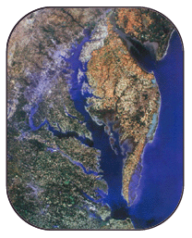

Chesapeake Bay Preservation Ordinance Revisions
Forestry and Natural Resources Commission
March 27, 2025
Notes:
For FNRC: Thank you for making time for our presentation. Before we start, we wanted to clarify that we have received the commissions letter about ordinances and regulations related to trees and suggestions for strengthening those requirements. Staff has started reviewing those suggestions and will be getting back to the commission on that later this year. This presentation is focused on updates Arlington needs to make to Chesbay ordinance in response to State amendments, which must be adopted by September.

Slide 2
Agenda
Overview of ordinance changes
Schedule
Break for Questions
Project Examples
Notes:
Here is our agenda for the meeting tonight.

Slide 3
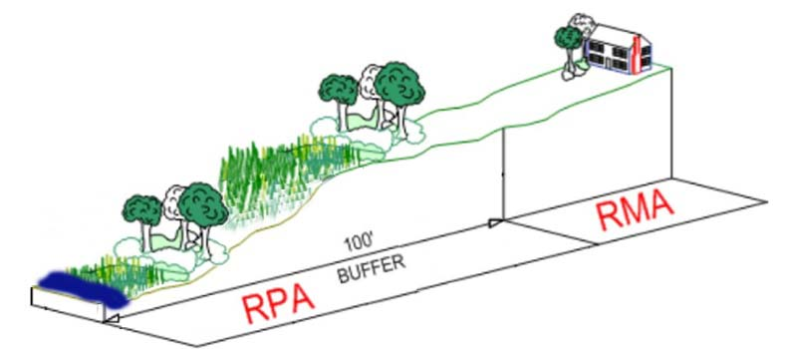
Chesapeake Bay Ordinance: Resource Protection Areas (RPAs) and Resource Management Areas (RMAs)
The ordinance defines two types of areas:
Resource Protection Areas protect stream buffers and other sensitive areas.
Resource Management Areas cover remaining land area to provide
additional protections.
Notes:
As a refresher, Virginia passed the Chesapeake Bay Preservation Act in 1988, to protect water quality in the Bay through land use management. When the Bay act was passed, that required local governments to adopt their own Chesapeake bay preservation ordinances, which Arlington did in 1992, and has updated several times since
The Chesapeake Bay Preservation Areas have two components. First, it establishes Resource Protection Areas including a 100 foot buffer around streams, wetlands and other sensitive areas. Second, is designates Resource Management Areas that encompass the rest of the County. Through RMAs, the County implements standards on other activities that can affect water quality.

Slide 4
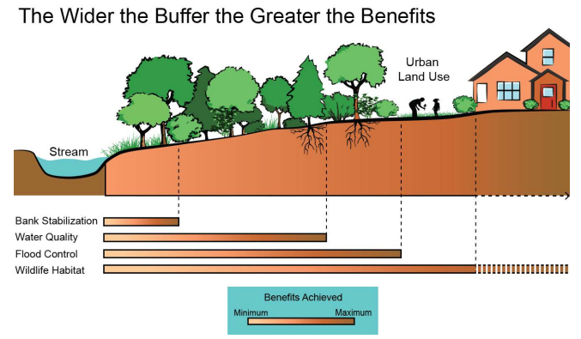
What Do RPAs Do?
Notes:
What are the benefits of RPA? Provide shade, stabilize soil and stream banks, Provide a place for flooding (help mitigate), filter and absorb runoff, and support wildlife habitat
Also talk about benefits of urban streets to a general audience

Slide 5
What Needs County Approval?
Development or redevelopment projects on properties where RPA is present (additions, rebuilds).
Any project requiring a building or land disturbing activities permit on an RPA property.
Adding new paved surfaces in the RPA (i.e. patios, walkways, parking/drives)
Adding new structures in the RPA (sheds, gazebos, garages)
The removal of vegetation from the RPA
Fences or retaining walls
An exception may be required for some projects. The basic submission for permitting is the Water Quality Impact Assessment (WQIA).

Slide 6
Why is Arlington Updating the Ordinance Now?
In 2020, The Virginia General Assembly passed a bill to make Chesapeake Bay Act amendments on trees and climate change
The Soil and Water Conservation Board adopted two amendments to its regulations in 2021 that:
  Added language that mature trees shall be protected during development in resource protection areas and resource management areas.
  Require “resilience assessments” for development within resource-protection areas to determine the potential impacts of sea-level rise and increased storm intensity due to climate change.
Arlington is updating our ordinance to include these required changes
Notes:
So you may be wondering why Arlington is making updates to the Chesapeake Bay Preservation Ordinance now? In 2020, the Virginia General Assembly passed a bill to make Chesapeake Bay Act amendments related to trees and climate change for any projects with new or redevelopment in the RPA. Arlington is required to updates to our Chesapeake Bay ordinance to include these State amendments. The deadline to adopt add the amendments to Arlington’s ordinance is September, 2025. We do understand that you may be anxious about what these changes mean for you as a property owner, and for any projects you may be planning. We’ve tried to include the required changes in simplest, user friendly way possible.
DEQ provided some feedback and other changes are based on model ordinance. DEQ is currently reviewing our draft ordinance and materials.

Slide 7
Chesapeake Bay Ordinance Revisions
New ordinance components focus on trees and climate change:
Tree amendments focus on codifying tree protections in Resource Protection Areas
Climate change amendments focus on coastal resilience and adaptation to climate change
Notes:
There are two main focus areas for the updates: strengthening tree protections and adding a requirement for a resilience assessment for development in the RPA

Slide 8
Tree Conservation in RPAs and RMAs
Adds definition for mature trees and provides extra protection
Prioritizes trees to be used to re-establish the 100-foot buffer.
Requires native plantings for buffer re-establishment, enhancement or mitigation, or to offset new encroachments in the RPA
Requires pruning or trimming over tree removal and stipulates pruning shall be done in accordance with ANSI A300 standards
Arlington was already doing this by policy, but this will make it required
Notes:
The tree amendments strengthen protection for all trees in Arlington on properties undergoing development in RPA and RMA areas, and add additional guidance for trees in RPA.
The tree amendments strengthen protection for RPA trees, as well as on properties undergoing development in RMA areas, and add additional guidance for trees in RPAs.
The amendments also include things like requiring trees to be used to replant the buffer, and requiring that tree and plants used to replant the buffer be native. Arlington was already meeting these requirements as a matter of policy, but these amendments will make them a requirement in the ordinance.

Slide 9
Mature Tree Definition
Mature tree - a canopy tree with a diameter at breast height (DBH) of 12 inches or greater
Understory tree - a DBH of four (4) inches or greater
Adds requirement that mature trees are protected during development and only removed when necessary for the proposed development.
Mature trees should be pruned or trimmed, in lieu of removal, when possible.
Notes:
The tree amendments strengthen protection for all trees in Arlington on properties undergoing development, and add additional guidance for trees in RPA.
The amendments establish a definition for mature trees (A canopy tree with a diameter at breast height (DBH) of 12 inches or greater or an understory tree with a DBH of four (4) inches or greater) and require that mature trees are protected during development and only removed when necessary for the proposed development. Mature trees should be pruned or trimmed, in lieu of removal, when possible.
The amendments also include things like requiring trees to be used to replant the buffer, and requiring that tree and plants used to replant the buffer be native. Arlington was already meeting these requirements as a matter of policy, but these amendments will make them a requirement in the ordinance.

Slide 10
Dead, dying or diseased trees or noxious vegetation
Requires written County approval prior to removing a dead, dying or diseased tree. This is current policy, but revised ordinance will include this requirement.
Requires trees be replaced within 6 months
Requires review and approval for land disturbance for removing dead trees or noxious vegetation.
Requires tree replacement when trees are removed to create sight lines, vistas, shoreline erosion control or access paths.
Notes:
There are also changes related to removing dead trees or noxious vegetation. The amendments will require written County approval prior to removing a dead tree, or if there would be land disturbance for tree removal or invasive plant control. The changes will require tree replacement if trees are removed to create sight lines or access paths.

Slide 11
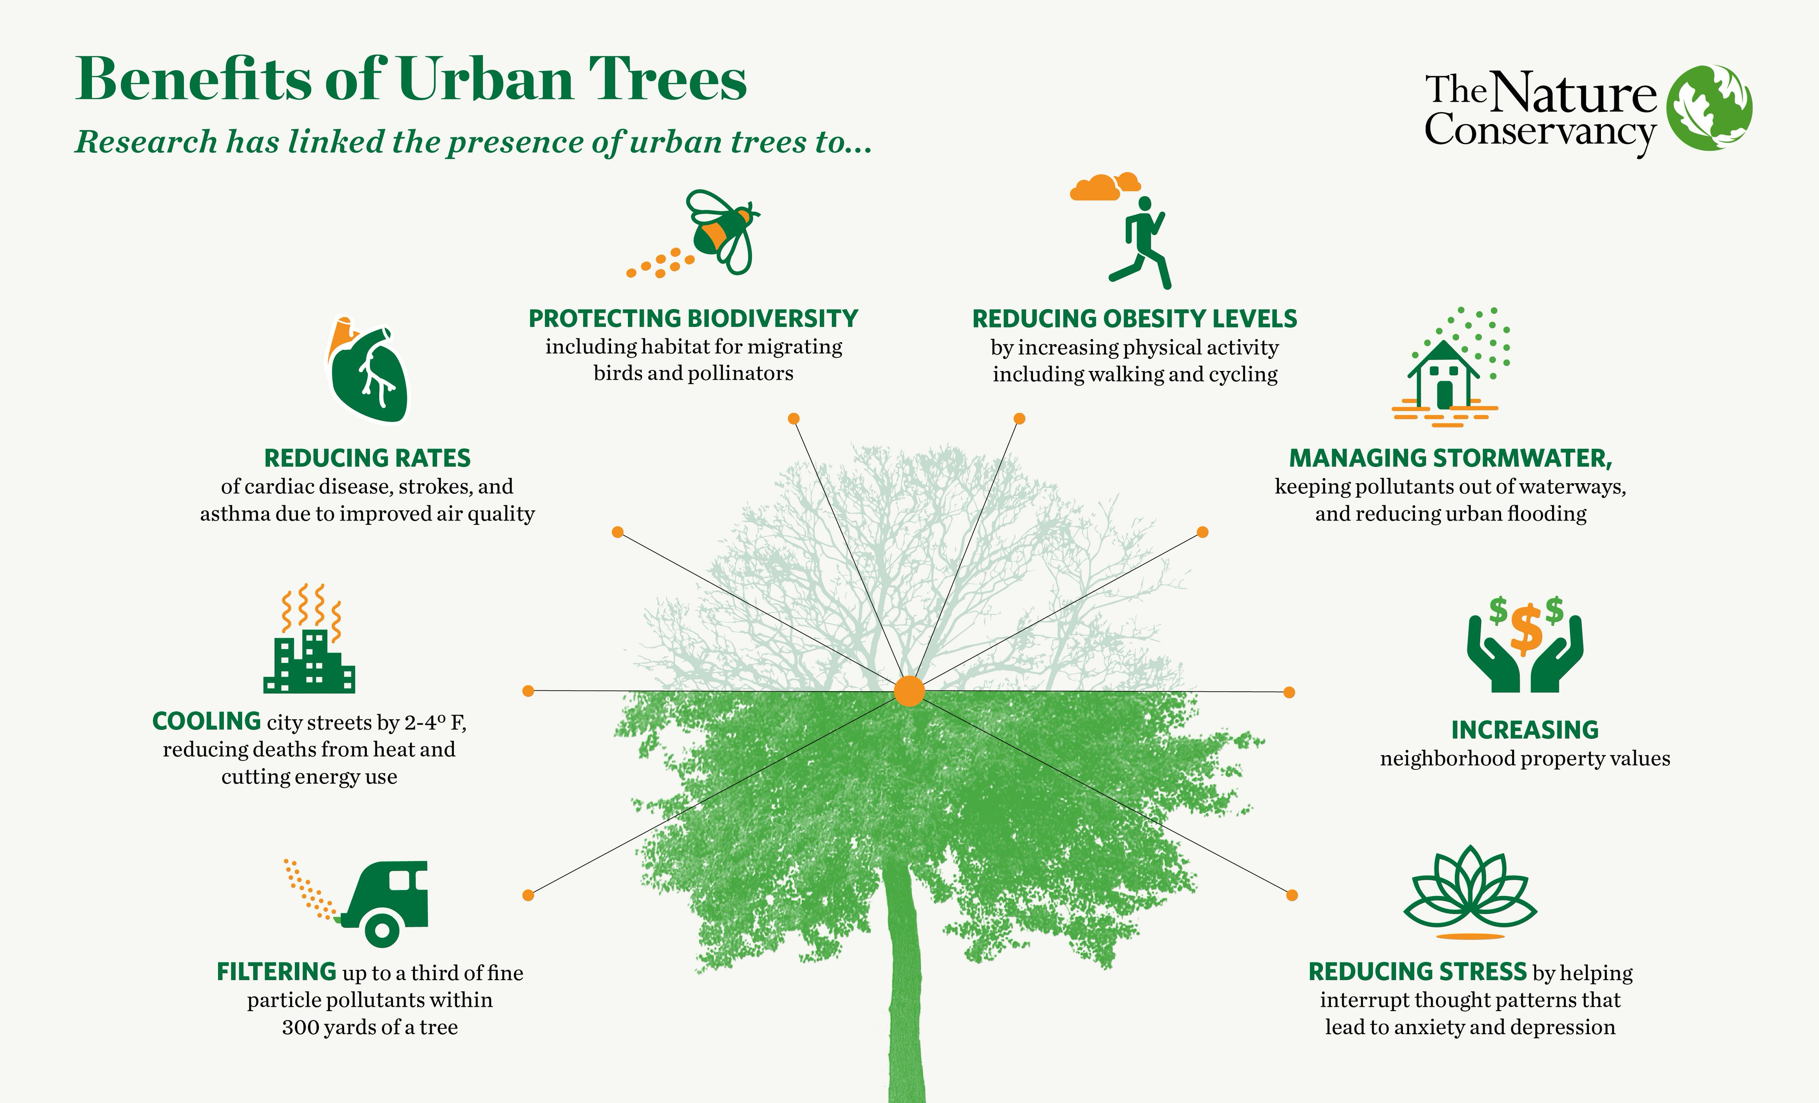
Tree Canopy Benefits
Notes:
While we are talking about trees, here is a quick reminder about all the benefits that urban trees provide to your property.
Cooling: Trees provide shade, which can cool the temperature of streets and pavement by 2–7° F.
Energy savings: Shaded areas use less energy for air conditioning.
Improved health: Trees absorb air pollutants, which can improve respiratory health.
Reduced stress: Seeing trees can improve focus and reduce stress.
Increased property value

Slide 12
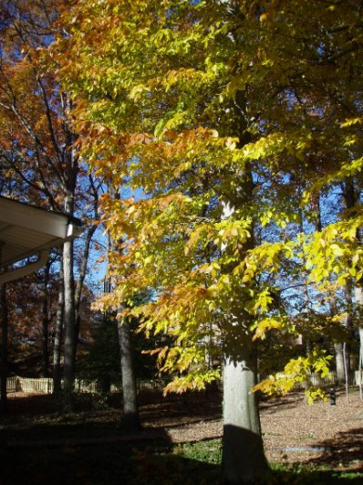
Tree Resources
Concerned about your trees? The maintenance of medium to large trees is best left to qualified arborists both in terms of evaluating the need and applying the treatment. While well executed pruning can sometimes reduce the risk of failure, poorly executed pruning can increase the risk. For a list of certified arborists in this area:
https://www.treesaregood.org/findanarborist/findanarborist
You can learn about proper pruning from this guide: https://www.arlingtonva.us/files/sharedassets/public/v/1/environment/documents/htprune.pdf
More resources are available here:
https://www.arlingtonva.us/Government/Programs/Office-of-Sustainability-and-Environment/Trees/Tree-Maintenance-and-Health
Notes:
Here is information about how to care for your trees.

Slide 13
Climate Change Adaptation
A Resilience Assessment is required for any proposed land development within the RPA to evaluate the impacts of climate change from flooding, storm surge or sea-level rise.
The WQIA Application Form has been revised to include questions regarding the Resilience Assessment.
If your property has RPA and is affected by flooding, storm surge or sea level rise, the County may require adaptation measures to limit climate impacts from your project and related impacts to adjoining properties
Notes:
The amendments also add new requirements related to climate change adaptation. For any land development in the RPA, a resilience assessment will need to be completed to assess the impacts of floodplains, storm surge or sea level rise. This requirement will not affect all properties with RPA, but only certain properties. The Water Quality Impact Assessment Form will include a section for the resilience assessment. If your property has RPA and is affected by floodplains, storm surge or sea level rise, you will need to include adaptation measures to limit climate impacts from your project and related impacts to adjoining properties

Slide 14
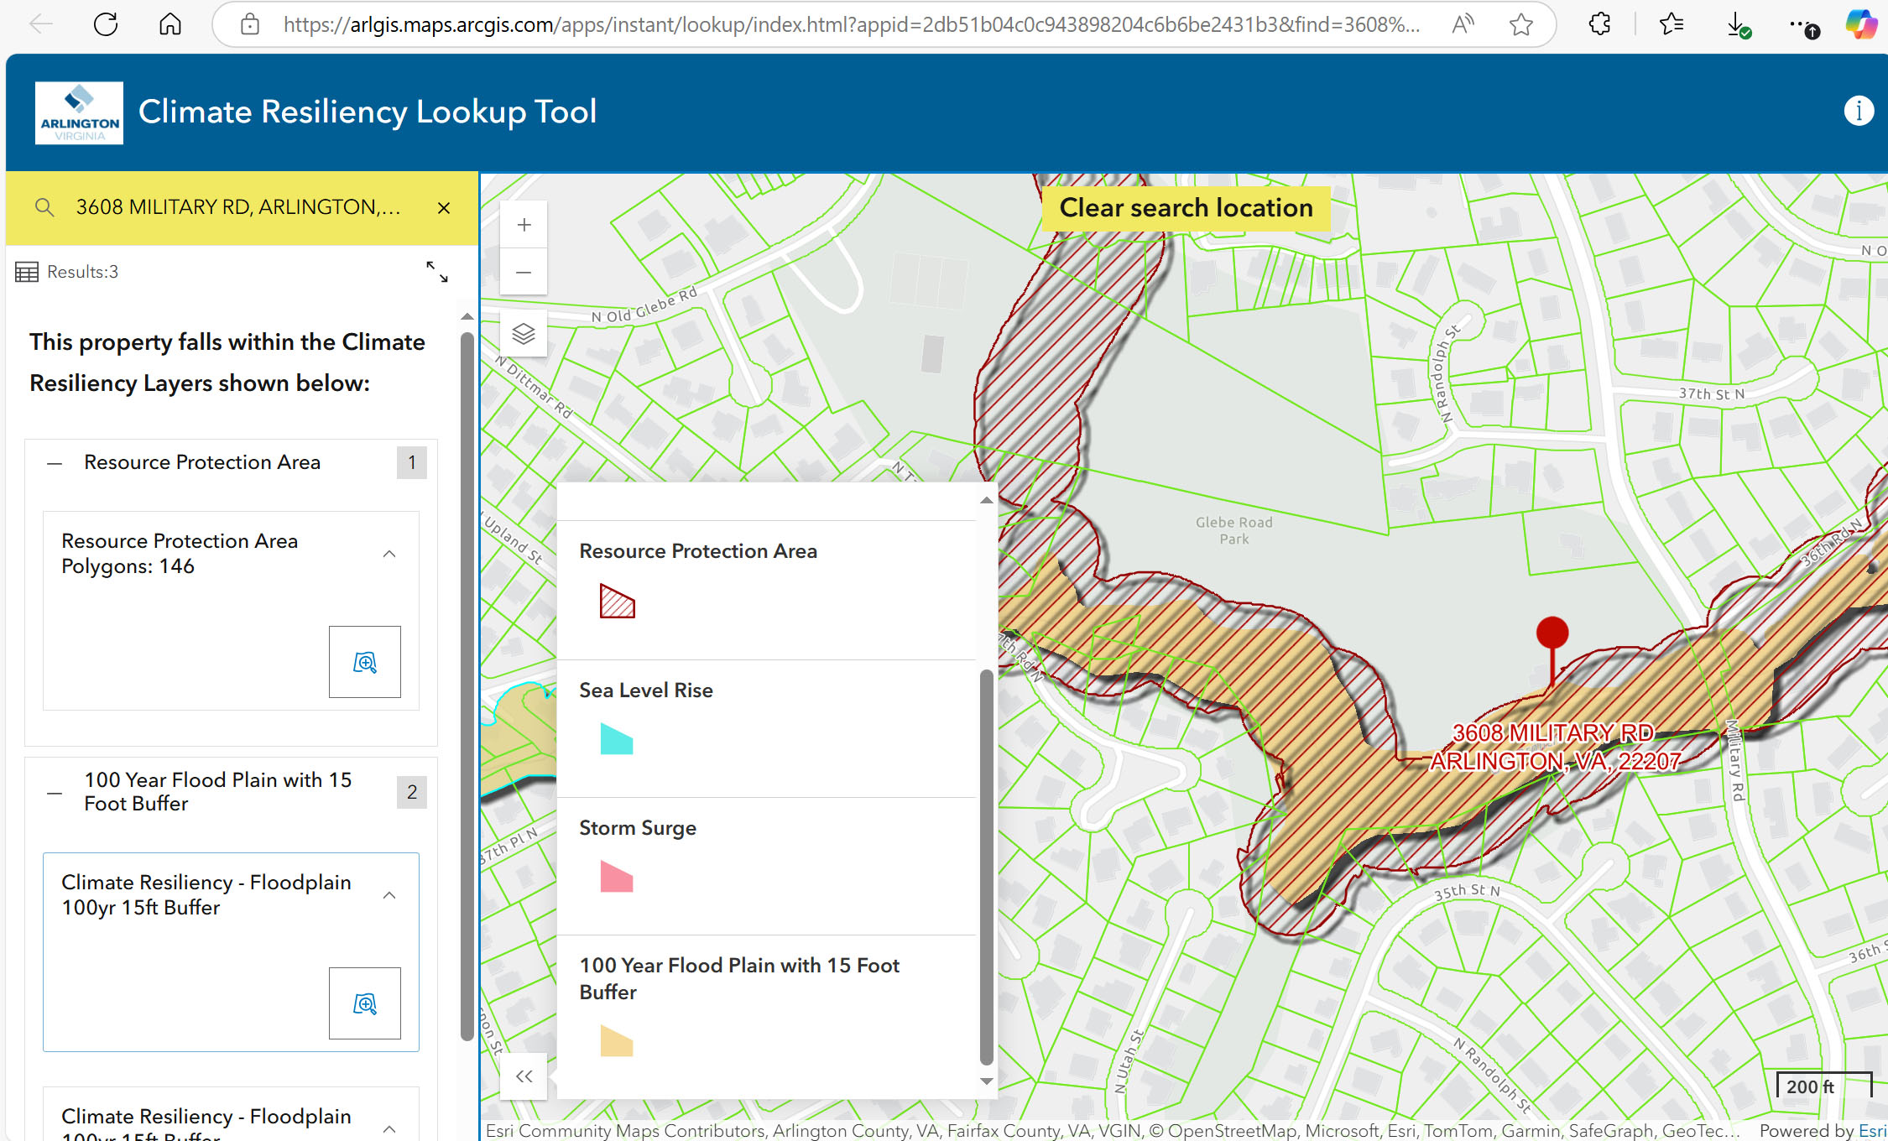
Notes:
So how will you know if your property has floodplain, storm surge or sea level rise? The County has created an interactive map that you can search. You can see the example from the map here. It will tell you if your property is affected by RPA, sea level rise, storm surge, or floodplain.
Number of Properties Affected
RPA Parcels - 1500
RPA and Floodplain Parcels - 527
Sea Level Rise - 35
Storm Surge - 10

Slide 15
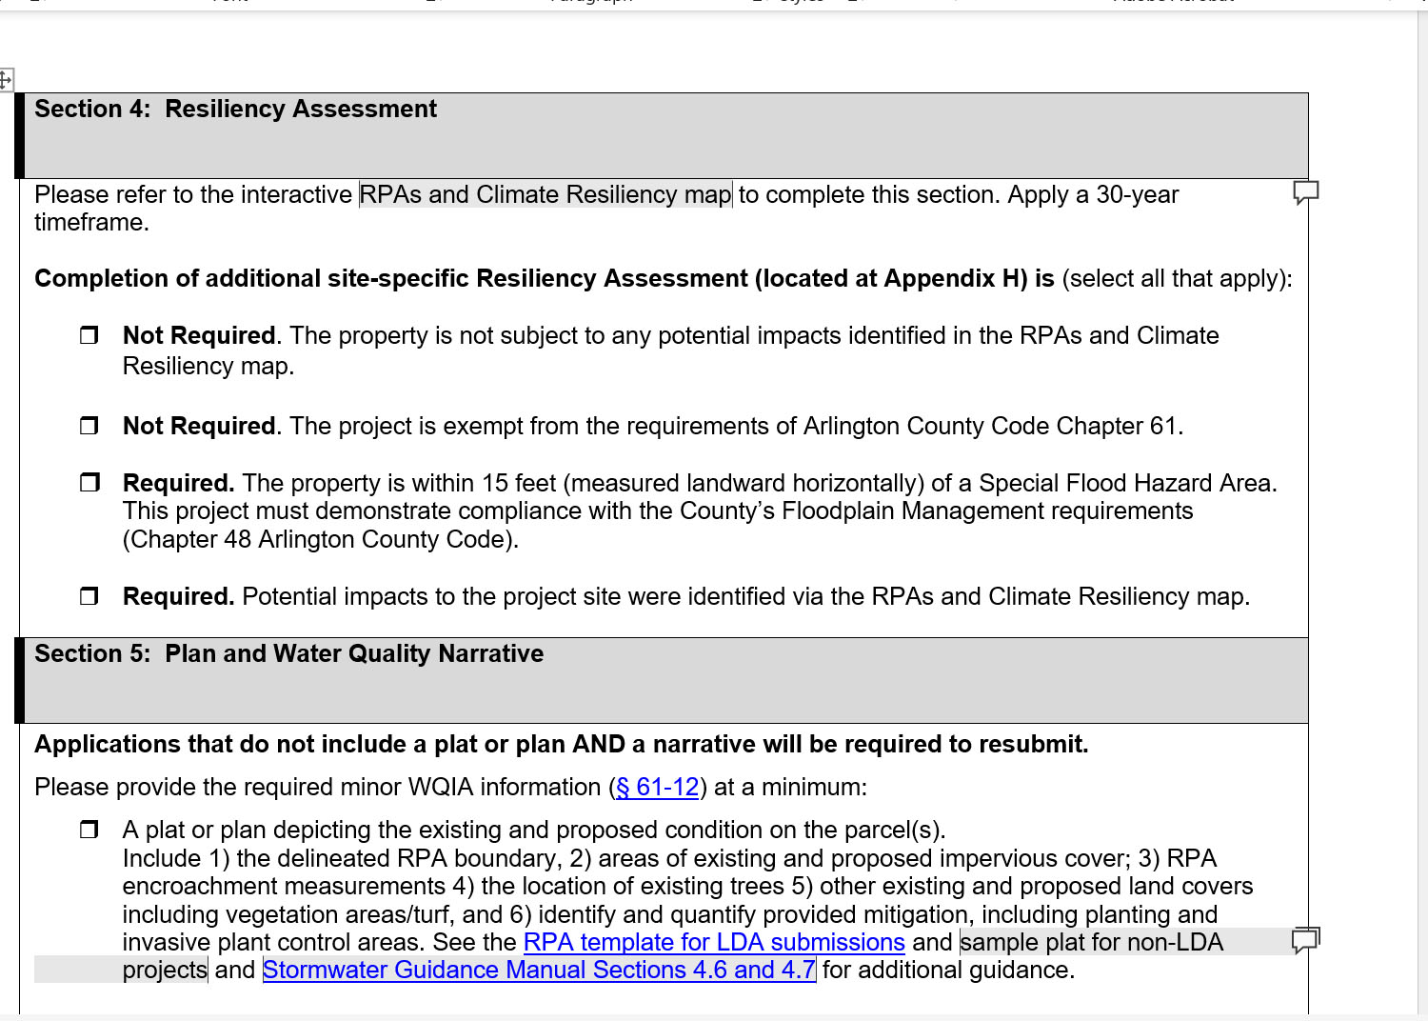
WQIA
Notes:
The WQIA Application Form has been revised to include questions regarding the Resilience Assessment.

Slide 16
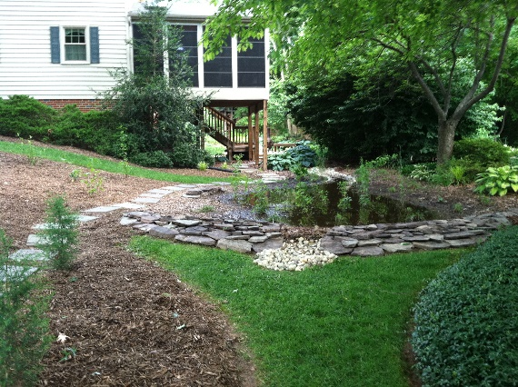
Nature-Based Adaptation Measures
A project, practice, or approach to mitigate or address coastal impacts from sea-level rise, storm surge, and flooding, including increased or recurrent flooding.
New “Allowed Use” in RPA, subject to criteria
Adaptation measures must be selected from lists of BMPS approved by official sources (Ches Bay Program, VA Stormwater Management Handbook, etc.)
Could be for climate-related impact mitigation or on a voluntary basis
Maximize preservation of existing natural vegetation
Comply with all federal, state and local requirements
County has discretion to approve on a case by case basis
Notes:
An additional change is that nature-based projects, such as a rain garden, are a new allowed use in the RPA. These projects could be for mitigation for a development project, or on a voluntary basis.

Slide 17
Living Shorelines for Shoreline Erosion Control
Clarifies requirement to be consistent with Virginia’s Wetland Act and VA Marine Resources Commission (VMRC) Tidal Wetlands Guidelines
Identifies requirement for VMRC permitting for hard and nature-based shoreline stabilization
Prioritizes living shorelines for stabilizing tidal shorelines over hard (seawalls, riprap, groins etc.) measures and requires hard stabilization projects to incorporate living shorelines to the extent practicable.
Arlington requires a WQIA for Living Shoreline projects unless otherwise approved by the Director
Notes:
The amendments also prioritize living shorelines for erosion control along shorelines. However this does not have much application in Arlington.

Slide 18
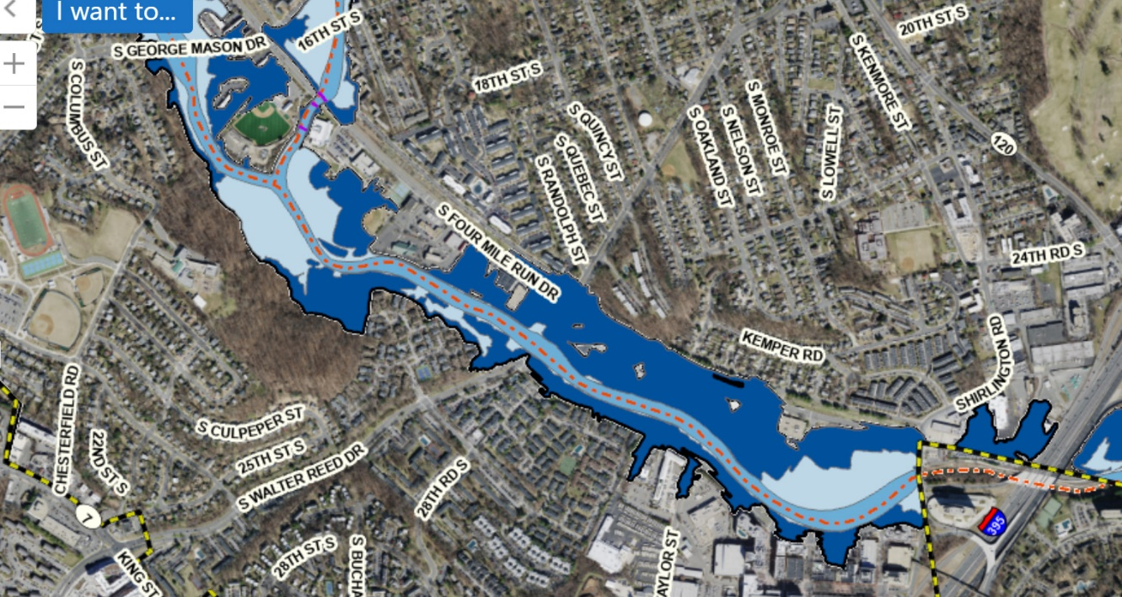

Know Your Flood Risk
Understand your flood risk: https://msc.fema.gov/portal/search
More than 20% of flood insurance claims are from low to moderate risk areas.
Purchase flood insurance.
Arlington residents are eligible for flood insurance discounts.
Contact your insurance agent for rates and coverage.
Notes:
We just like to remind all property owners that it is important to understand your flood risk and take steps to protect yourself such as purchasing flood insurance, or floodproofing around your home.

Slide 19
Other updates
Clarifies or adds definitions: Accessory structure or Accessory use, Adaptation Measure, Canopy Tree, Construction Footprint, Critical Root Zone, Limit of Moderate Wave Action (LiMWA), Living Shoreline, Mature Tree, Nature-based solution, Principal Structure, Storm Surge, Understory Tree, Water Dependent Facility
Updates references to Erosion and Stormwater Management Ordinance (they were combined in 2024)
Notes:
Other updates include clarifying and adding definitions, and updating references to the Erosion and Stormwater Management Ordinance (that were combined in 2024)

Slide 20
Schedule
February - Letter to property owners, informational video available online
March 20 – Virtual Meeting
March/April – Commission presentations, Development community outreach
May – Follow up letter to property owners
May – Request to advertise Planning Commission/County Board
June – County Board Consideration of Revised Ordinance
September – Deadline for amendments to be adopted
Fall – Information sessions for property owners
Notes:
Here is some information on the schedule for these updates. Currently, DEQ is reviewing our draft revised ordinance and revised WQIA, but we will share them as soon as we are able.
Also need to update Stormwater Guidance Manual. Brochure.

Slide 21

Break for Questions
Notes:
We are going to pause here to take any questions that you may have. We also have some project examples that we will go through in a moment that may help to answer questions as well.

Slide 22
Project Examples

Slide 23
Removal of a Dead/Dying RPA Tree
Existing RPA Requirements | New Climate Change/Trees Amendments
At discretion of the property owner | At the discretion of the property owner
Tree assessment by a certified arborist to document condition and need for removal | Tree assessment by an ISA certified arborist or person accredited by the American Society of Consulting Arborists to document condition/removal need.
Review and approval by County required. | Review and written determination by County required.
Replacement (1:1) may be required. | Replacement (1:1) required within 6 months.
 | Tree removal cannot occur where pruning is sufficient.
Notes:
We have some projects examples.

Slide 24
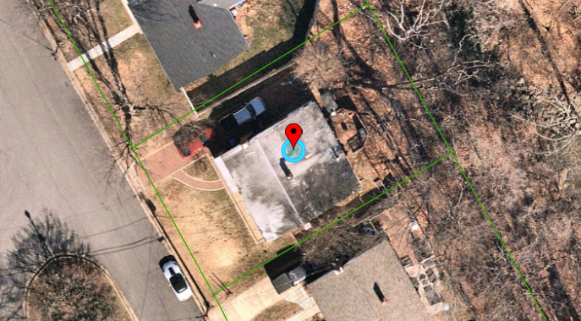
New Addition in RPA, No Floodplain
Notes:
7 S. Edison Street

Slide 25
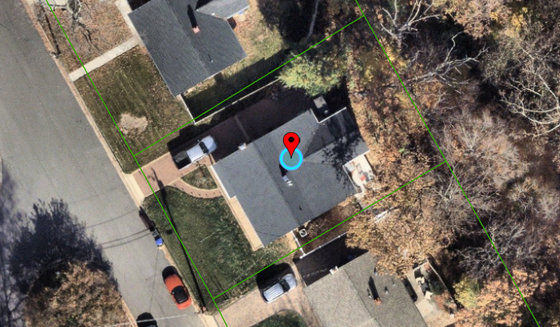
New Addition in RPA, No Floodplain
Notes:
7 S. Edison Street

Slide 26
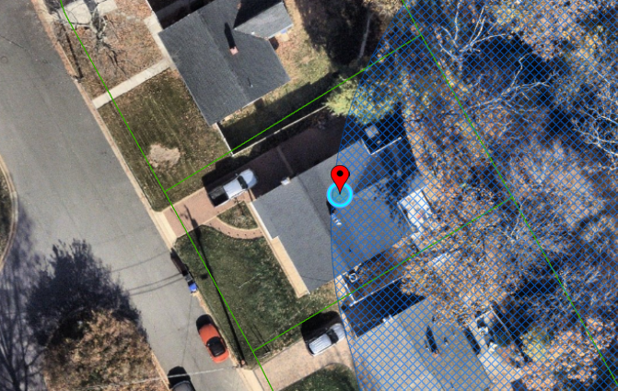
New Addition in RPA, No Floodplain
Notes:
7 S. Edison Street

Slide 27
New Addition in RPA, no Floodplain
Existing RPA Requirements | New Climate Change/Trees Amendment
Administrative Exception | Administrative Exception
Plat, WQIA + Exception Request | Plat, WQIA +Exception Request
 | Buffer restoration = 2x new RPA impervious footprint + 1x any additional RPA disturbance Due to lack of space would likely require this as enhancement of existing forested area
Invasive Plant Management | Invasive Plant Management
Notes:
7 s edison st
No resiliency requirement

Slide 28
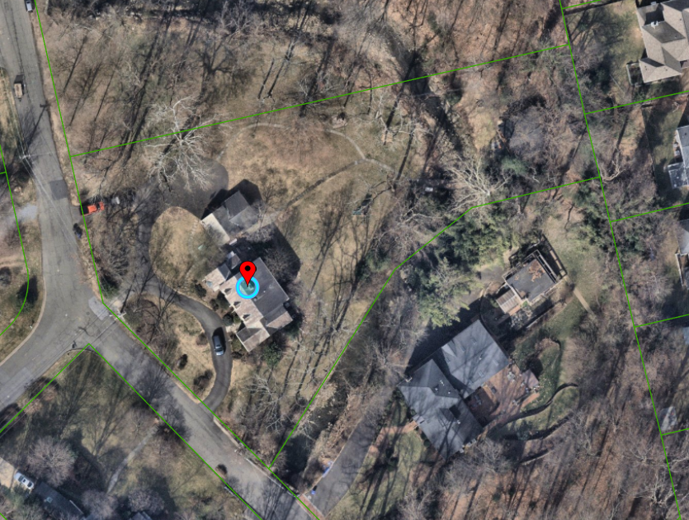
New Addition in RPA & 100 Yr Floodplain
Notes:
3801 N Dumbarton

Slide 29
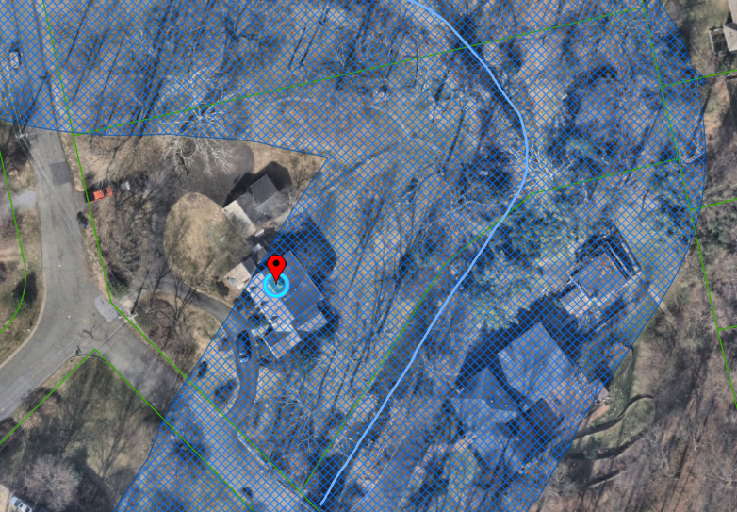
New Addition in RPA & 100 Yr Floodplain
Notes:
3801 N Dumbarton

Slide 30
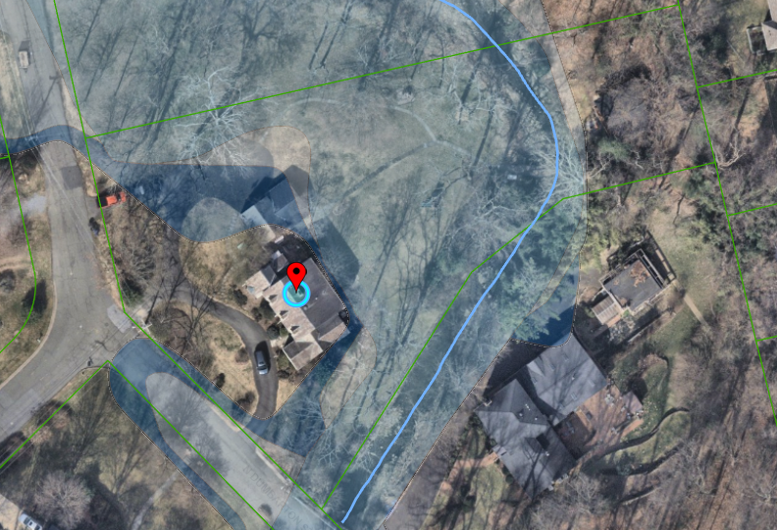
New Addition in RPA & 100 Yr Floodplain
Notes:
3801 N Dumbarton

Slide 31
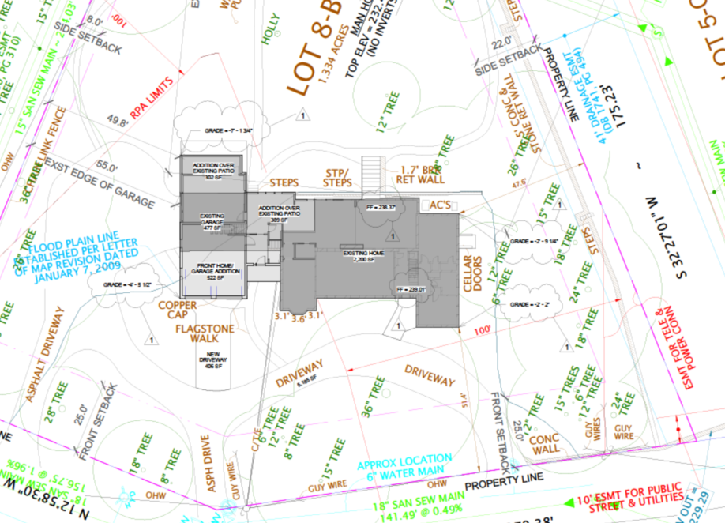
New Addition in RPA & 100 Yr Floodplain
Notes:
3801 N Dumbarton

Slide 32
New Addition in RPA & Floodplain
Existing RPA Requirements | New Climate Change/Trees Amendment
Administrative Exception | Administrative Exception
Plan, WQIA + Exception Request | Plan, WQIA +Exception Request
 | Resiliency Assessment (Appendix H)
Tree replacement – 1 tree | Tree replacement – 1 tree
 | Buffer restoration = 2x new RPA impervious footprint + 1x any additional RPA disturbance
Invasive Plant Management | Invasive Plant Management
Separate floodplain review | Floodplain review/approval required for RPA approval
 | Conditions/alterations/adaptation measures could be required to reduce flood risk including to adjacent properties
Notes:
Removes 1 - 8” dogwood (1 mature tree) and 1 shrub
New amendment – replacement as close to stream as is practical for the site

Slide 33
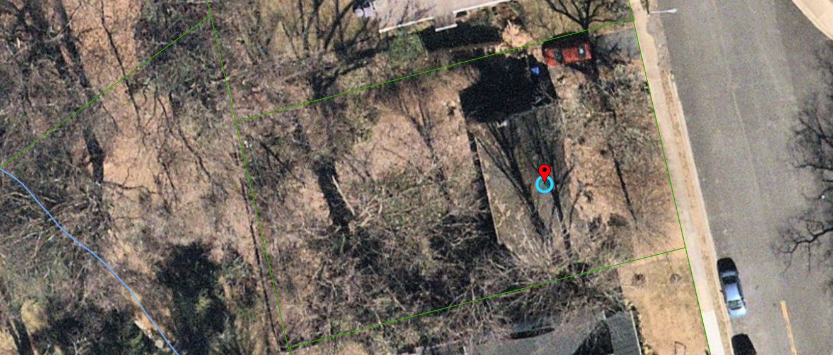
New Single-Family Home in the RPA
within 15 ft of a Floodplain
Notes:
3380 N Dickerson ST

Slide 34
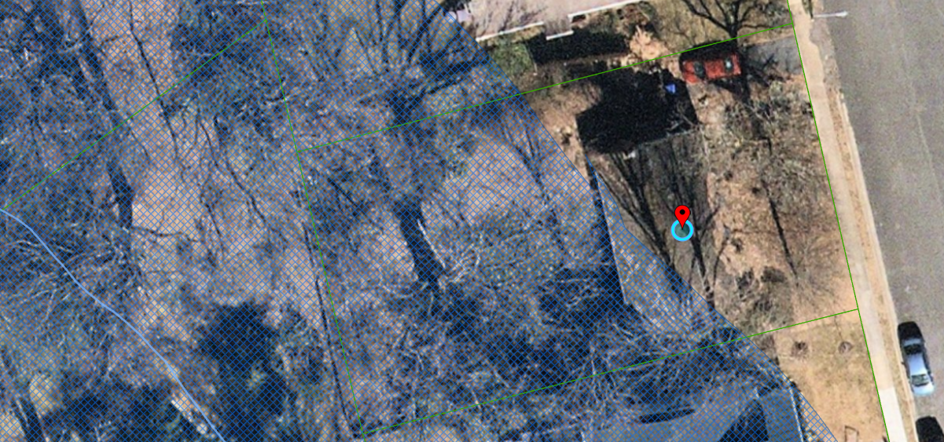
New Single-Family Home in the RPA
within 15 ft of a Floodplain
Notes:
3380 N Dickerson ST

Slide 35
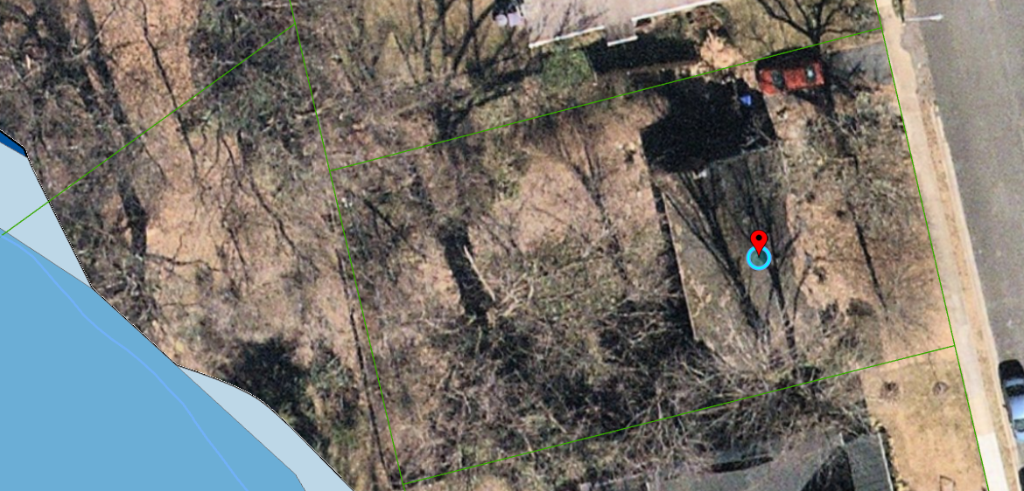
New Single-Family Home in the RPA
within 15 ft of a Floodplain
Notes:
3380 N Dickerson ST

Slide 36
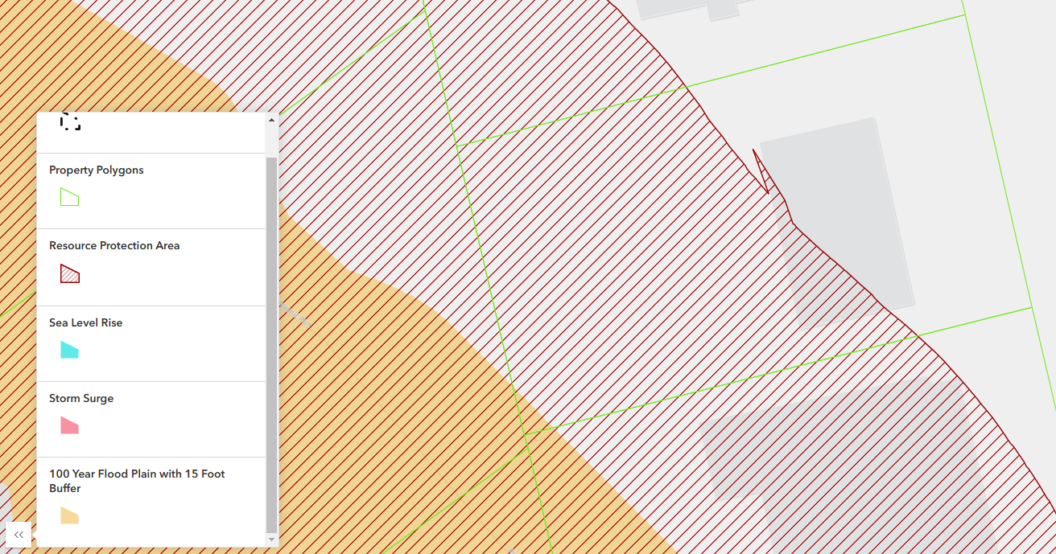
New Single-Family Home in the RPA
within 15 ft of a Floodplain
Notes:
3380 N Dickerson ST

Slide 37
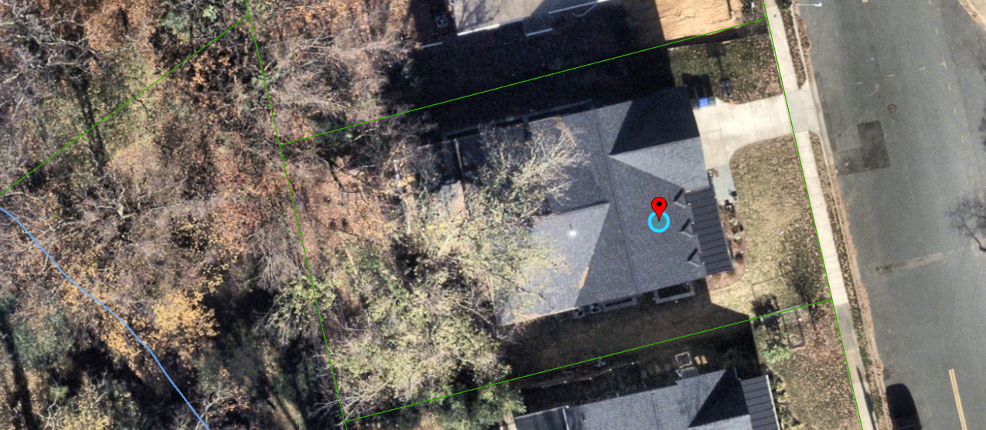
New Single-Family Home in the RPA
within 15 ft of a Floodplain
Notes:
3380 N Dickerson ST

Slide 38
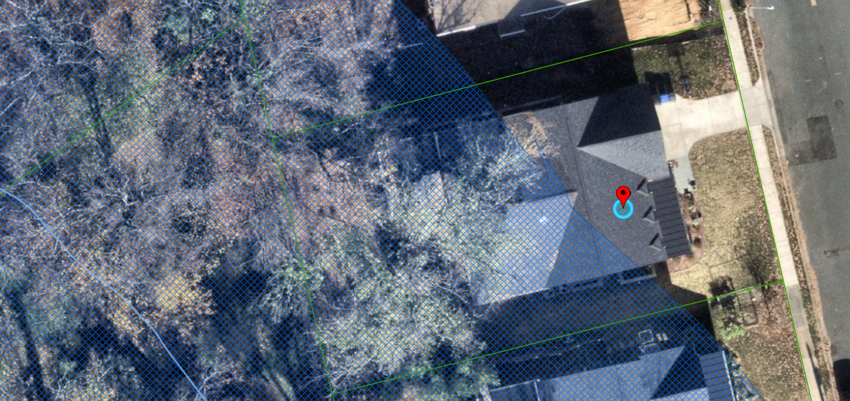
New Single-Family Home in the RPA
within 15 ft of a Floodplain
Notes:
3380 N Dickerson ST

Slide 39
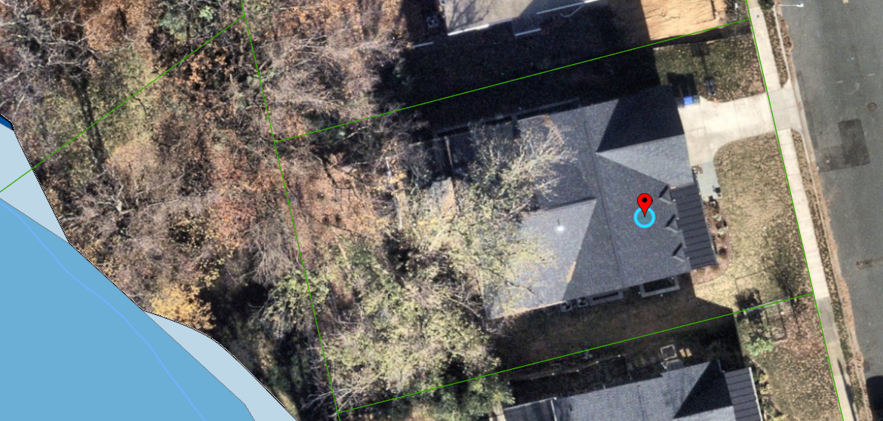
New Single-Family Home in the RPA
within 15 ft of a Floodplain
Notes:
3380 N Dickerson ST

Slide 40
New SFD in RPA, with 15 feet of a Floodplain
Existing RPA Requirements | New Climate Change/Trees Amendment
Formal exception (CBORC) | Formal exception (CBORC)
Plan, WQIA + Exception Request | Plan, WQIA +Exception Request
 | Resiliency Assessment (Appendix H) – no impact
Tree replacement | Additional review of mature tree removal Tree replacement
Native planting = 1x new RPA impervious footprint | Native planting = 2x new RPA impervious footprint + 1x any additional RPA disturbance
Invasive Plant Management | Invasive Plant Management
Long Term Maintenance Agreement | Long Term Maintenance Agreement
 | Floodplain review/approval required.
Notes:
Adds 983 sf of impervious cover to the RPA
Removed 3 mature trees – a 10”, 20” and 38” red maples

Slide 41
Questions?
Notes:
Also need to update Stormwater Guidance Manual. Brochure.

Slide 42
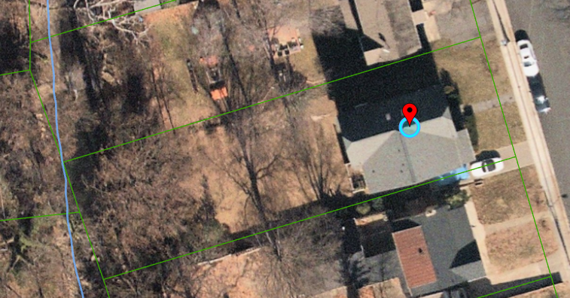
New Patio in RPA & 100 Yr Floodplain
Notes:
612 N Abingdon Street

Slide 43
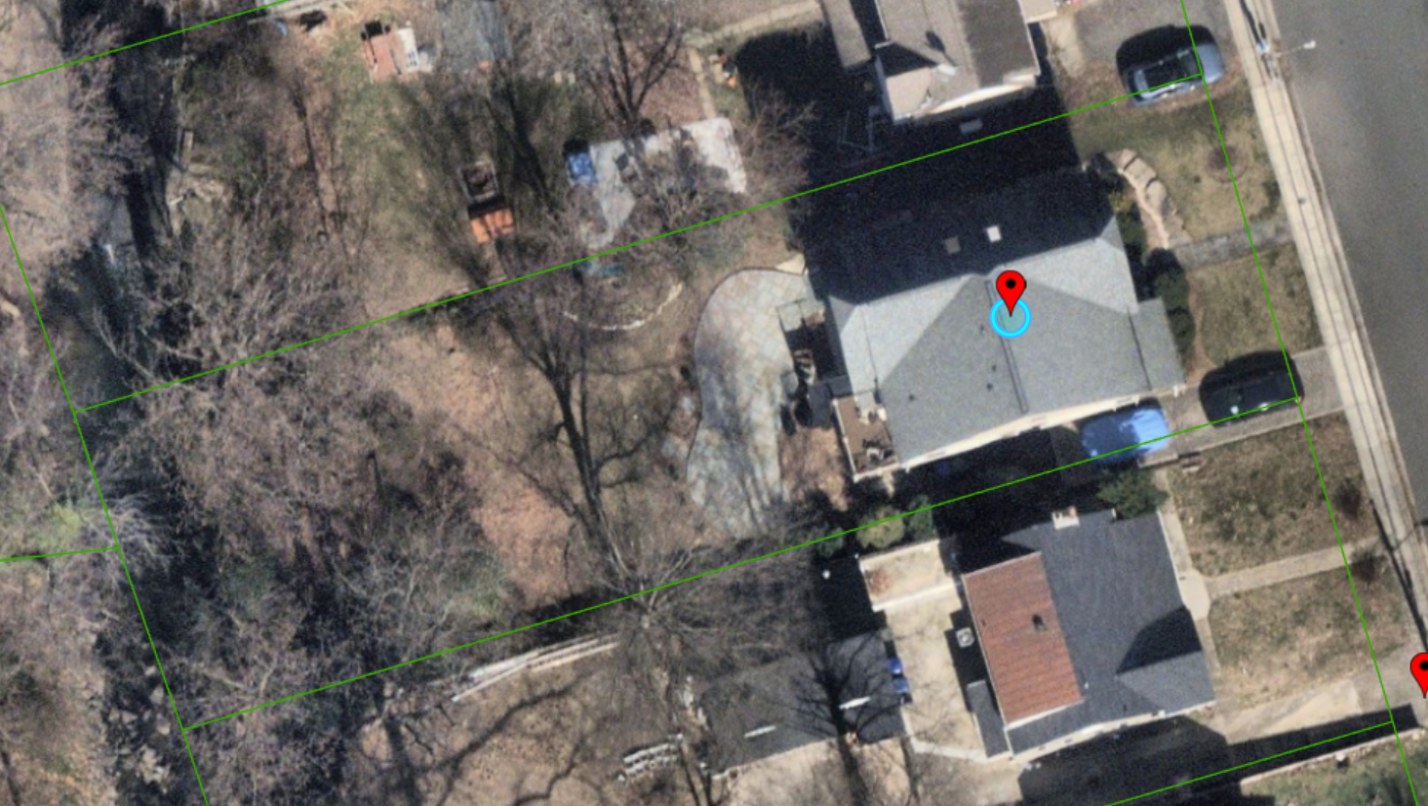
New Patio in RPA & 100 Yr Floodplain
Notes:
612 N Abingdon Street

Slide 44
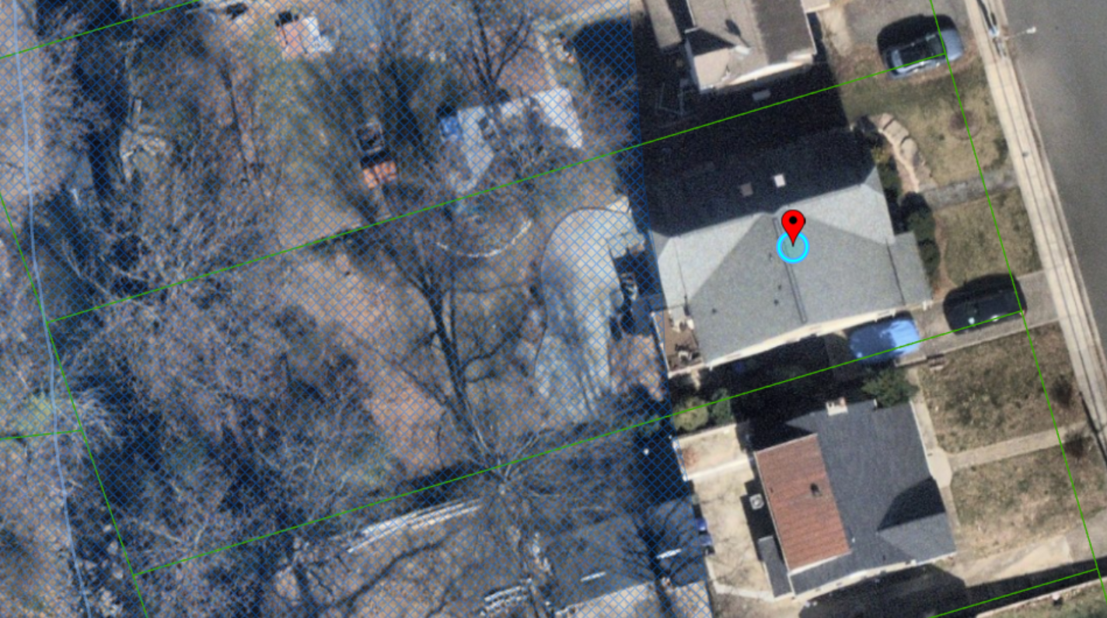
New Patio in RPA
New Patio in RPA & 100 Yr Floodplain
Notes:
Project adds new impervious cover and is closer to the stream than the existing house

Slide 45
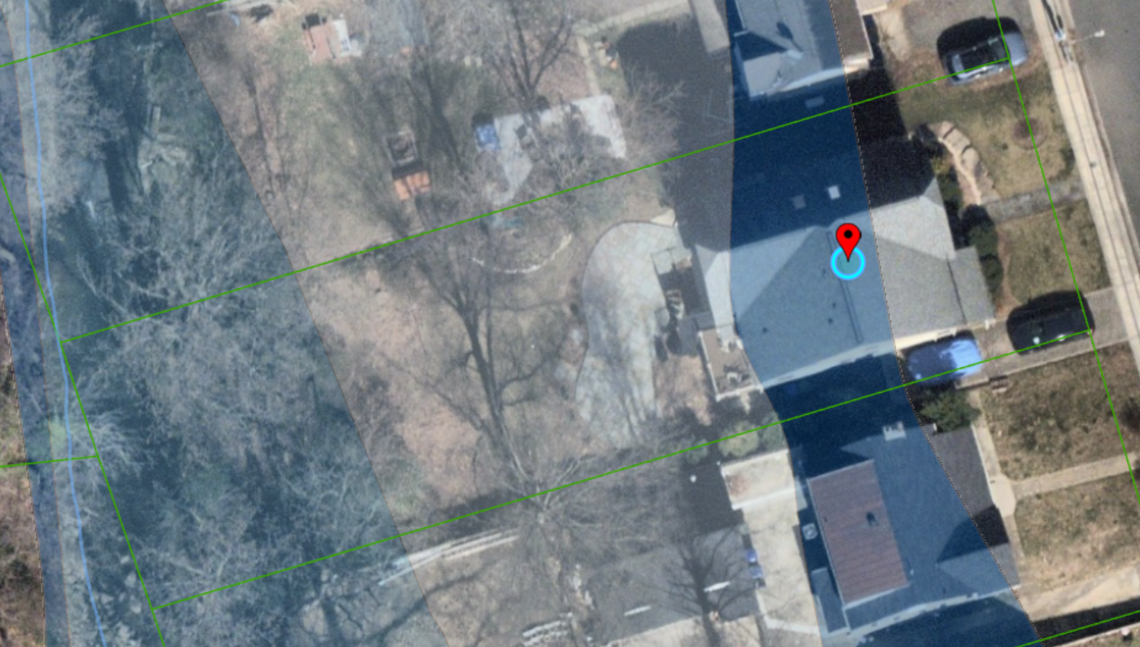
New Patio in RPA & 100 Yr Floodplain

Slide 46
New Patio in RPA & Floodplain
Existing RPA Requirements | New Climate Change/Trees Amendment
Formal exception (CBORC) | Formal exception (CBORC)
Plan, WQIA + Exception Request | Plan, WQIA +Exception Request
 | Resiliency Assessment (Appendix H)
New Native Planting Area = Patio footprint | New Native Planting Area = Patio footprint + any disturbed RPA area
Pervious patio construction | Pervious patio construction
Long Term Maintenance Agreement | Long Term Maintenance Agreement
Per policy, CBORC will not issue exception without floodplain approval. | Floodplain review/approval required.
 | Conditions/alterations/adaptation measures could be required to reduce flood risk including to adjacent properties
Notes:
Patio adds 450 sf to RPA; 450 sf of mitigation required
No tree removal

