Slide 1

Trespass Towing Fees
Timothy Perez
Towing Program Manager
August 7th, 2025

Slide 2
Agenda
Review of VA Code – Towing Fees
Current Arlington County Towing Fees
Towing Fees of Surrounding Jurisdictions in Planning District 8
Review of 2024 Virginia State Corporation Commission (SCC) Report of Policy Proposals for the Regulation of Towing Fees
Summary

Slide 3
VA State Code
No hookup and initial towing fee of any passenger car shall exceed $210.
For towing a vehicle between 7:00 p.m. and 8:00 a.m. or on any Saturday, Sunday, or holiday, an additional fee of no more than $30 per instance may be charged;
In no event shall more than two such fees be charged for towing any such vehicle.
Fuel surcharge expired 07/01/2025.
§ 46.2-1233.1. Limitation on charges for towing and storage of certain vehicles

Slide 4
Arlington County Towing Fees
Hookup & initial towing fee(GVWR of 7,000 lbs. or less): $135
  Last increased in 2014.
Towing a vehicle between 7:00 p.m. and 8:00 a.m.: $30
Towing on any Saturday, Sunday, or holiday: $30
In lieu of towing or “drop” fee: $20

Slide 5
Towing Fees of Surrounding Jurisdictions – Planning District 8
Jurisdiction | Hookup & Towing Fee (GVWR < 7,000 Lbs.) | Towing 7:00 PM - 8:00 AM | Towing Saturday, Sunday, Holiday
Fairfax County*** | $150 | $30 | $30
City of Alexandria** | $150 | $30 | $30
City of Falls Church** | $135 | $25 | $25
City of Fairfax* | $210 | $30 | $30
City of Manassas* | $210 | $30 | $30
City of Manassas Park* | $210 | $30 | $30
Loudon County* | $210 | $30 | $30
Prince William County** | $150 | $30 | $30
*Jurisdiction does not regulate trespass towing or limit fees. Absent local limits on trespass towing fees set pursuant to VA Code § 46.2-1233, operators can charge no more than the maximum charges provided in VA Code § 46.2-1233.1.
**As of 6/30/2025. No confirmation as to if jurisdiction will adopt new state max rate.
***Fairfax County TTAB Proposed raising hookup fee to $210 in July 2025.

Slide 6
2024 SCC Towing Fee Analysis
In 2024, the VA SCC commissioned a report analyzing fees for trespass towing operations. Findings include:
The 2024 maximum allowable rate of $150 should be reset based on current cost estimates. A new Trespass Tow base rate between $200 and $210 appears reasonable.
  Based on increases to Transportation Consumer & Transportation Producer Price Index and operating costs, as well as a national comparison to states that regulate trespass towing.

Slide 7
2024 SCC Towing Fee Analysis Continued
The current additional fees for working night shifts, weekends, and holidays remain reasonable. A change does not appear to be justified at this time.
Use a percentage to automatically adjust any minimum rate or eliminate the minimum entirely. Should a percentage be chosen, a new minimum rate of 75% of the maximum appears reasonable and should apply to all districts (75% of $210 = $157.50).
96% of counties across the state are silent or defer to the state maximum rate for trespass towing fees.

Slide 8
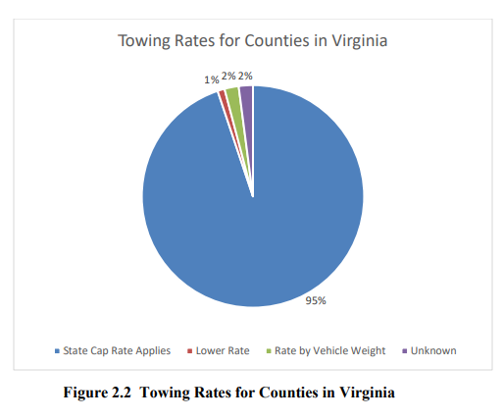
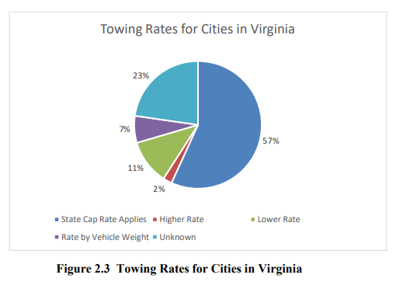
Towing Rates by County & City (Statewide)
Policy Proposals for the Regulation of Fees Charged for the Removal of Motor Vehicles, Trailers, and other Trespassing Vehicles Left on Private Property in the Commonwealth (Chapter 245, 2024) Page 15

Slide 9
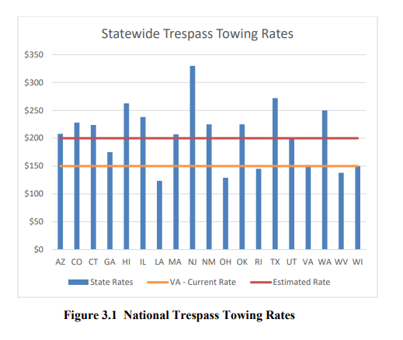
A National Comparison
Based on a national comparison of states that regulate trespass towing, a towing fee between $200 and $210 appears reasonable.
Policy Proposals for the Regulation of Fees Charged for the Removal of Motor Vehicles, Trailers, and other Trespassing Vehicles Left on Private Property in the Commonwealth (Chapter 245, 2024) Page 19

Slide 10
Consumer Price Index Analysis
Index | Percent increase between 2016 & 2023 | State Max Rate Based on Index*
Transportation Consumer Price Index | 32.44% | $198.66
Transportation Producer Price Index | 39.45% | $209.17
Economic Inflation Modeling | 4% | $189.80
*Based on $150 max rate for initial hookup & tow.
Policy Proposals for the Regulation of Fees Charged for the Removal of Motor Vehicles, Trailers, and other Trespassing Vehicles Left on Private Property in the Commonwealth (Chapter 245, 2024) Page 20

Slide 11
Tow Operator Costs
Expense** | Annual Costs (2024) | Cost Per Tow
Labor | $43,287 | $27.75
Fuel | $36,923 | 23.67
Equipment | $61,274 | $39.28
Fringe Benefits | $32,116 | $20.59
General Overhead | $105,220 | $67.45
Profit (15%)* | $41,823 | $26.81
Total | $320,683 | $205.54
Based on operating costs, a $205 towing fee is reasonable, allowing for a 15% profit margin.
*Based on moderate risk business profit margins of 10-20% across sectors. 10% represents low risk businesses (i.e., professional services); 20% high risk businesses (i.e., construction).
**Costs estimates based on 1,560 tows per year, or 130 tows per month.
Policy Proposals for the Regulation of Fees Charged for the Removal of Motor Vehicles, Trailers, and other Trespassing Vehicles Left on Private Property in the Commonwealth (Chapter 245, 2024) Page 25

Slide 12
In Summary
State maximum rates for initial hookup & towing have increased ($210 effective 7/1/2025). Additionally, the fuel surcharge expired in the state code.
Arlington County’s max for initial hookup & tow is $135. This fee has been in effect since 2014.
  Only one out of eight other jurisdictions within Planning District 8 has a $135 towing fee.
96% of counties in VA either don’t have a specific towing ordinance or reference the Code of Virginia, which allows fees up to maximum rate for trespass towing.

Slide 13
In Summary
The SCC’s Report recommends a towing fee of $200 to $210 is fair.
  Pricing based on increased inflation, changes to consumer price indexes, & a national comparison.
The SCC’s report allows for a 15% profit margin; pricing based on tow operator’s costs supports a $205 fee.
The SCC’s Report suggests a minimum fee in the Va. Code be at least 75% of the state max (75% of $210 = $157.50). This has not been adopted.
  Arlington County’s current fee is 64% of the state maximum rate.
NOTE: Fee suggestions made by VA SCC are being presented for the Board’s review; Neither the Board, nor staff are recommending fee increases at this time.

