Slide 1
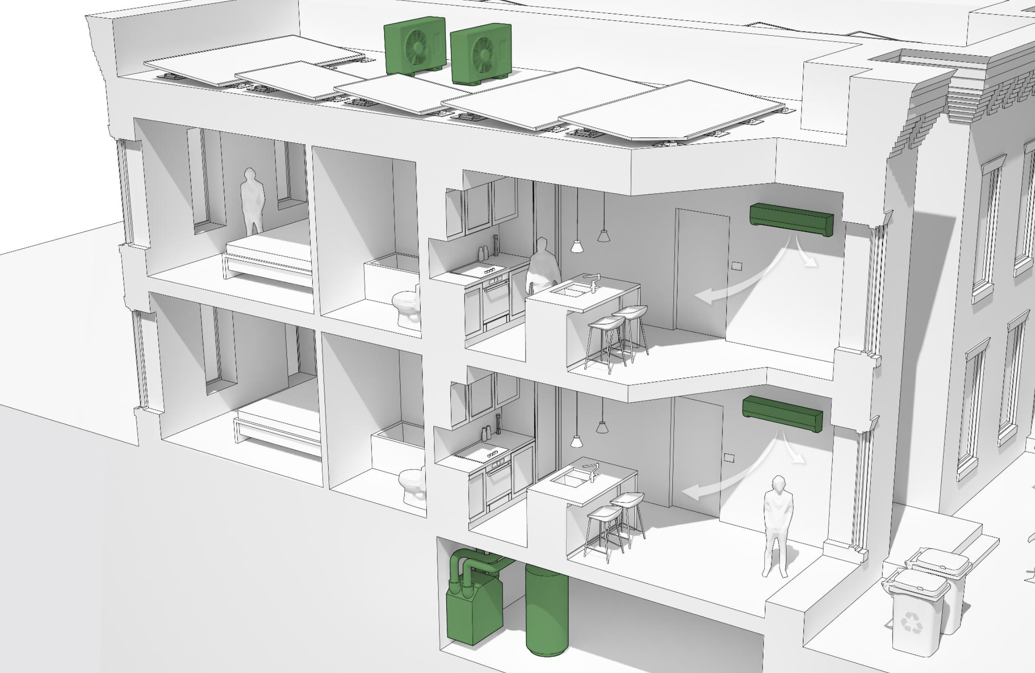
Green Building and Climate Policy in the District
Casey Studhalter
Green Building and Climate Branch
Urban Sustainability Administration
Notes:
Name, title
Master in urban planning and spent years at the US Green Building Council developing and supporting green building rating systems
Agency – like DNR, wide range of topics under “Energy and Environment” umbrella. Wildlife biologists, floodplain regulators, stormwater regulators,
USA functions like a Mayor’s Office of Sustainability in many other cities
Focused on all aspects of sustainability – people, planet and profit. Think tank
Green building team has no enforcement role. Work closely with colleagues at DCRA to enforce and DGS for DC-owned.
Separation can be both helpful and challenging at times
Provide insights into DC climate planning and policies to help ensure real estate and buildings industry knows where DC is heading
Help to value and/or sell built environment
Assets vs liabilities

Slide 2
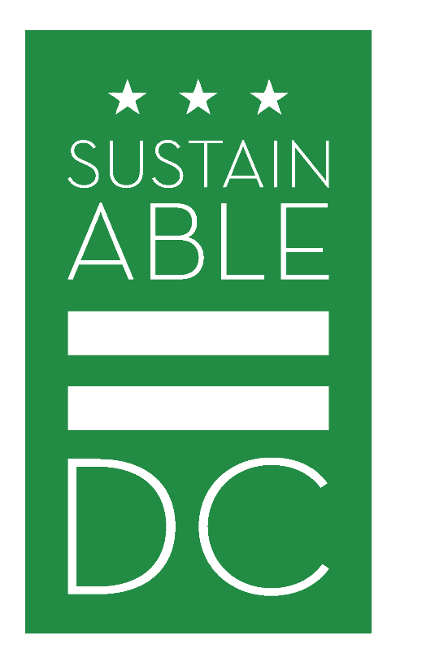
Goals for 2032
ADAPT TO CLIMATE CHANGE
CLIMATE READY BUILDINGS
CUT ENERGY USE 50%
50% RENEWABLE ENERGY
NET ZERO NEW BUILDINGS
NET ZERO RETROFITS
CUT GHG EMISSIONS 50%
Mayor Bowser Commitment to ZERO Carbon by 2050
Notes:
SDC Vision: Make DC the healthiest, greenest, most livable city for all District residents
Originally launched 2013, provides broad vision for addressing sustainability throughout the District
Broad = 167 actions and 36 goals across 13 topics
Updated with SDC 2.0 in 2018
Make it a plan for everyone
Get new people involved to shape it
Increase quantitative rigor
SDC’s top goals included
Cut energy use by 50%
Grow use of renewable energy to 50%
Cut GHG emissions by 50%
SDC has spawned companion plans to drill down and implement many of those measures envisioned
Climate Ready DC focuses on climate resilience and adaptation to a changing climate
Clean Energy DC focuses on climate mitigation as Districts energy and climate action plan
Adopted in 2018 after several years of research, analysis and engagement
57 detailed action items to achieve the goals identified in SDC.
Three categories – buildings, energy supply and transportation
Carbon Free DC planning under way now to chart path from 2032 to carbon neutrality by 2050

Slide 3
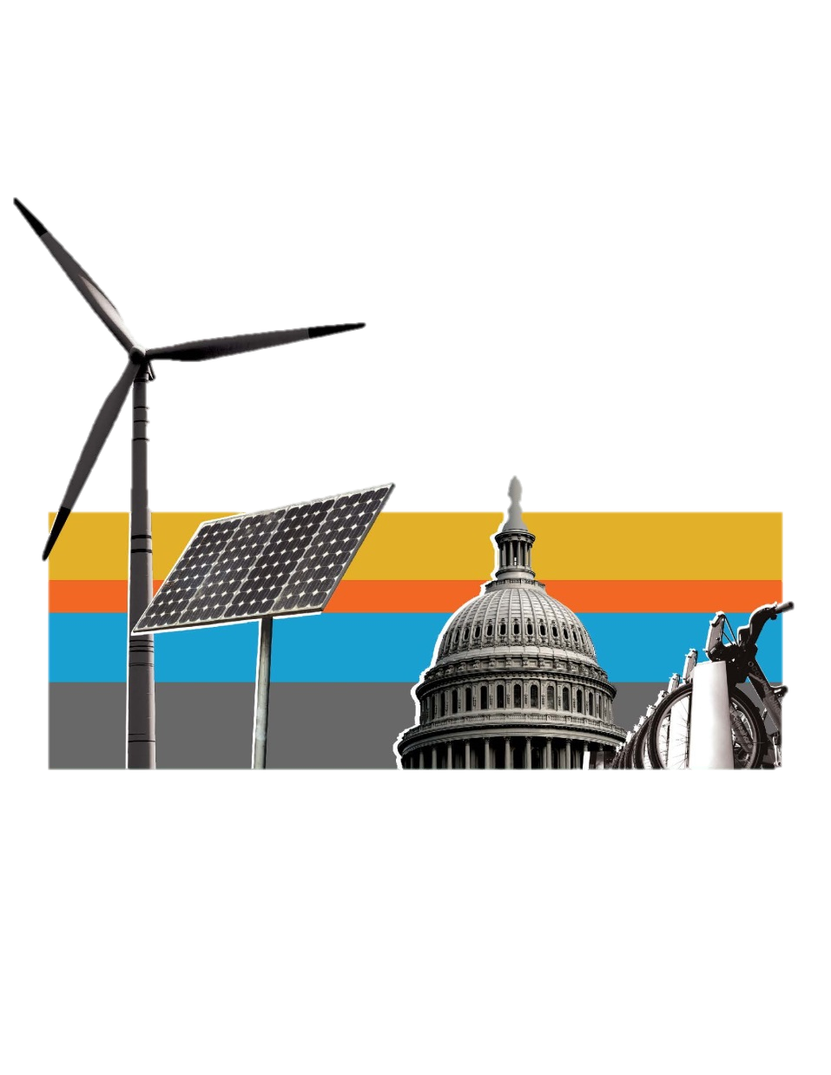
CLEAN ENERGY DC
MEANS….
New Buildings
Adopt a Net-Zero Energy building code by 2026
Existing Buildings
Improve the performance of existing buildings by implementing a Building Energy Performance Standard
100% Renewable Electricity
Require 100% renewable electricity by 2032, and 10% from local solar by 2041
CLEAN ENERGY DC OMNIBUS ACT OF 2018
Notes:
Focus on both new and existing buildings
Existing is the biggest challenge but also biggest opportunity as the city is only building so many new buildings.
Energy piece focused on energy providers to source clean energy, not end users.
Clean Energy Omnibus Amendment Act of 2018, passed in 2019, implements the last two aspects of the plan.
CEDC plan, and mayor’s endorsement, has changed tenor around NZE codes
CEDC plan helped socialize goals before Council passed legislation enacting some of the biggest ones

Slide 4
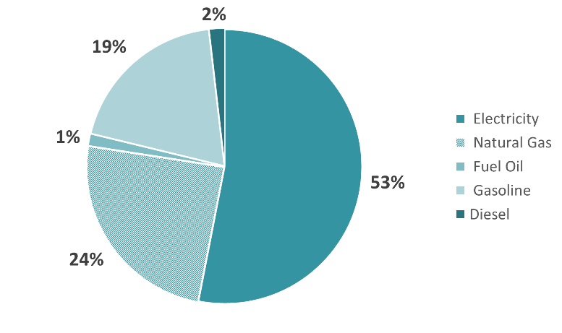
DRIVERS OF GHG EMISSIONS IN DC
MODELED PROPORTION OF GHG EMISSIONS BY SECTOR
GHG Emissions from Energy Source in DC
Notes:
Chart is taken from the modeling performed as part of Clean Energy DC Plan
Shows the proportion of DC’s total GHG emissions that are anticipated to come from the building sector – 74%
This is significantly higher than in other US cities as DC does not have a large industrial sector and a stronger transit mode-split than others. It does not mean that DCs buildings are any worse
This demonstrates the importance of building efficiency as a corner stone of any Climate Action Plan

Slide 5
Notes:
New construction anticipated to contribute 10% of the needed savings
Existing buildings 20%
With an ambitious goal and short timeline to act, all actions matter. Not “either, or”.
2019 GHG inventory shows 31% decrease in GHG emissions since 2006 baseline.
Represents 63% of the 2032 reduction goal, but still a long way to go.
Most savings from greening region’s electric grid (68%) and decreased EUI in commercial office (48%)

Slide 6
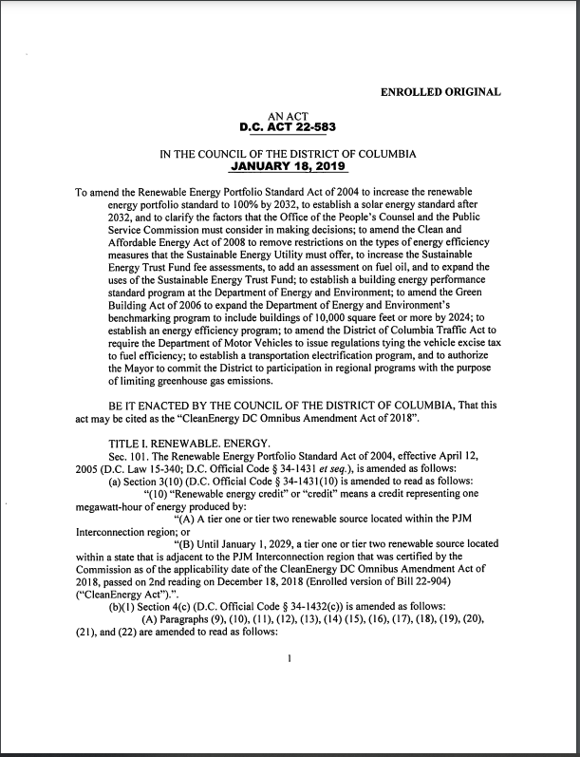
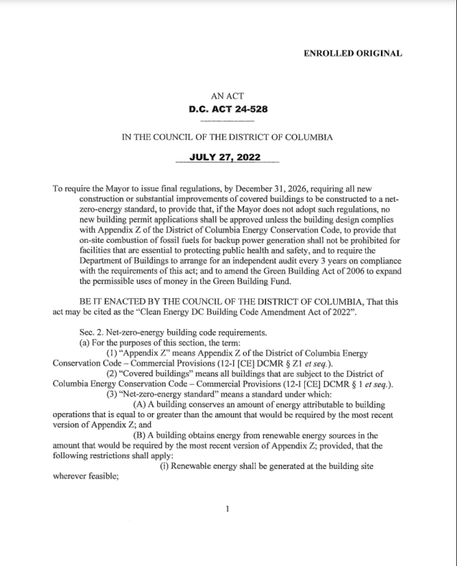
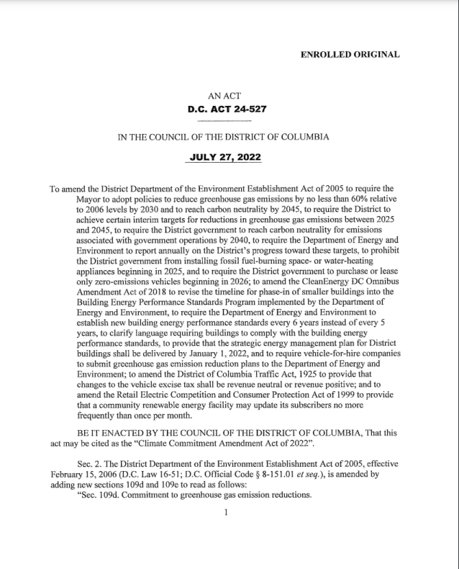
POLICY CONTEXT
Clean Energy DC Omnibus Act
2006 | Green Building Act | LEED, most public + private construction
2010 | Clean + Affordable Energy Act | Benchmarking: phase in public + private construction 10,000+ sf
2014 | Green Construction Code | Everything not under the GBA
2020 | EV Readiness Act | 20% new parking is EV ready
2021 | Clean Energy DC Act | BEPS Cycle 1, Energy Star-based; no fossil fuel equipment in Rx compliance paths
2022 | DC SEU contract | Elimination of nat gas incentives from SEU
2023 | Proposed energy code | Energy cost to site energy, increase efficiency
2024 | Greener Gov’t Bldgs Act | NZE/Electric new DC-owned/financed bldgs
2026 | Bldg Code Amendment Act | NZE bldg code + electrification, all bldgs
2027 | Clean Energy DC Act | BEPS Cycle 2... Trajectory/GHG-based?
2032 | Clean Energy DC Act | 100% RPS/fossil fuel-free grid, 10% solar
2040 | Climate Commitment Act | Government operations carbon neutral
2045 | Climate Commitment Act | DC is carbon neutral
Building Code Amendment Act
Climate Commitment Act

Slide 7
QUESTIONS?
Casey Studhalter
Green Building Team Lead
Urban Sustainability Administration
casey.studhalter@dc.gov
202-535-2460

Slide 8
NOTEWORTHY POLICIES AND REGULATIONS
New Construction & Major Renovations
Net-zero Energy
Electrification
Embodied Carbon*
Existing Buildings
Energy and Water Benchmarking
Building Energy Performance Standard (BEPS)
Solar Renewable Energy Credits (SRECs)
Inflation Reduction Act
* Proposed only

Slide 9
NET-ZERO ENERGY AND ELECTRIFICATION
NZE codes are called for in Clean Energy DC Plan (Recommendation NC.1)
Clean Energy DC Building Codes Amendment Act (signed July 2022)
Required by December 31, 2026 or else Appendix Z will be the Energy Code for all new construction and substantial rehab
Defines NZE as all-electric, banning gas in new construction & substantial rehab starting January 1, 2027
Voluntary NZE alternative pathways in 2017 DC Energy Code (includes App. Z)
Next planned energy code update in 2023/2024
Targeting building electrification and increased efficiency
Following update planned for late 2026
Stepping down to reach mandatory NZE

Slide 10
EMBODIED CARBON
Not currently measured or regulated
Clean Energy DC and SDC didn’t address
Next frontier for DC
Mayor established goal of carbon neutrality Districtwide by 2050
Climate Commitment Act (signed July 2022)
Carbon neutrality by 2045
Carbon Free DC strategy under development, will address embodied carbon
Shift to a consumption based GHG inventory

Slide 11
NOTEWORTHY POLICIES AND REGULATIONS
New Construction & Major Renovations
Net-zero Energy
Electrification
Embodied Carbon*
Existing Buildings
Energy and Water Benchmarking
Building Energy Performance Standard (BEPS)
Solar Renewable Energy Credits (SRECs)
Inflation Reduction Act
* Proposed only

Slide 12
BENCHMARKING 101
What is benchmarking?
Annual report of energy and water usage to DOEE
This is a measurement of your building’s performance – There are several metrics that track performance, such as total energy usage by fuel type, energy usage per square foot, ENERGY STAR score
What does DOEE do with this data?
Data from all covered buildings is publicly disclosed (and is used to generate the BEPS)
When is it due?
April 1 of every year
https://doee.dc.gov/energybenchmarking
@DOEE_DC #BEPSDC
@DOEE_DC #BEPSDC

Slide 13
Covered Buildings
2010 and on – DC-owned buildings >10,000 sq. ft.
2014 and on – Private buildings > 50,000 sq. ft.
2022 and on – Private buildings > 25,000 sq. ft.
2025 and on – Private buildings > 10,000 sq. ft.
Third Party Data Verification Required
Beginning 2024 and every three (3) years etc.
BENCHMARKING 101 – Recent changes
https://doee.dc.gov/energybenchmarking
@DOEE_DC #BEPSDC
@DOEE_DC #BEPSDC

Slide 14
BUILDING ENERGY PERFORMANCE STANDARD 101
What are BEPS?
In a few words – minimum performance threshold for existing buildings
How does DOEE determine the minimum threshold?
DOEE uses benchmarking data to calculate the local median, for each building type
Which years did DOEE use to determine if my building meets BEPS?
The BEPS were established using CY2019 data, and buildings were evaluated based on CY2019 data
https://doee.dc.gov/energybenchmarking
@DOEE_DC #BEPSDC
@DOEE_DC #BEPSDC

Slide 15
BEPS Timeline - Extended
2021
2022
2023
2024
2025
2026*
Repeat
2027
BEPS Set Every 6 Years
Pathway Selection
6-Year Compliance Cycle for Buildings that do not meet the standard
Data Analysis & Enforcement
3rd Party Data Verification Every 3 Years
3rd Party Data Verification Every 3 Years
Annual Benchmarking
Annual Benchmarking
Annual Benchmarking
Annual Benchmarking
Annual Benchmarking
Annual Benchmarking
Annual Benchmarking
* COVID-19 PHE adjustment – automatic 1-year delay of BEPS compliance cycle
@DOEE_DC #BEPSDC

Slide 16
BEPS APPLICABILITY
As the benchmarking requirements ratchet down in square footage over time, the buildings will be required to meet the BEPS in the following periods until all buildings 10,000 sq. ft. and over are following the performance standards.
BEPS 1: Private buildings >50,000 sq. ft. and DC-owned >10,000 sq. ft.
BEPS 2: Private buildings >25,000 sq. ft. and DC-owned >10,000 sq. ft.
BEPS 3: Private buildings and DC-owned >10,000 sq. ft.
@DOEE_DC #BEPSDC

Slide 17
COMPLIANCE PATHWAYS PERFORMANCE REQUIRMENTS
Building owners have a variety of pathways to choose from to bring their buildings into compliance:
Performance Pathway
Prescriptive Pathway
Alternative Compliance Pathway
Reduce site energy usage 20%
Provides flexibility for building owner
Implement cost-effective efficiency measures
Following a set pathway provides certainty
Special circumstances such as portfolios, deep retrofits, etc.
Allows building owner to apply to follow a path with special criteria
Standard Target Pathway
Reach the standard for your property type
Only available for property type groups above the National median
@DOEE_DC #BEPSDC

